Slide 1
Graph Data Science
Algorithms
Using network intelligence to identify critical nodes and natural planning zones in the automotive supply chain
56,083
171,163
28,049
7
Nodes in
Full Projection
Relationships
Projected
Products in
BOM Projection
Natural Planning
Zones Found
Team: Bekithemba Nkomo · Peter Mangoro · Masheia Dzimba
Moetz et al. (2020) · Neo4j Graph Data Science · Spring 2026 Capstone

Slide 2
EDA Recap — What We Discovered About the Supply Network
10 exploratory questions across 5 chapters — from graph validation to downstream impact mapping
EDA 1-3: Graph Validation
EDA 4: BOM Composition
EDA 5: Lead Time Risk
EDA 6: Hidden Timeline
Confirmed 56,135 nodes, 16 relationship types,
all properties intact.
The network is real and complete.
Engine, gear and seat each appear in all 28,000
car products. Battery in only 10.7% of vehicles.
Seat transit: 23-day lead time.
Battery transit: 20 days.
All other routes are 2 days or less.
Pipeline stock ordered 22 days ago still arriving.
Days 1-4 of the plan are already on autopilot.
EDA 7: Lane Capacity
EDA 8-9: Buffer & Pipeline
EDA 10: Downstream Impact
Battery production capped at 294 units/week
— 7x lower than all other routes at 2,100.
ZP7 holds most opening stock. Seat (56,000)
and battery (35,860) pipeline locked before week 1.
Seat sub-components affect 42.99% of car portfolio.
Engine, gear and seat = 100% fleet exposure.
Moetz et al. (2020) · Neo4j Graph Data Science · Spring 2026 Capstone

Slide 3
Analytical Questions Recap — From Awareness to Precision
3 strategic questions combining multiple signals — going beyond EDA to produce actionable ranked outputs
AQ 1: Component Concentration Risk
AQ 2: Arc Structural Fragility
AQ 3: Risk-Adjusted Priority
Which BOM components have the largest downstream disruption impact if disrupted?
Which supply routes are most exposed — lead time, capacity and buffer combined?
Which components to protect first — BOM reach, supplier count and route fragility combined?
componment_seat2: 12,039 upstream products,
48,156 dependency paths — largest BOM hub.
Seat family dominates top 4 positions.
Gear components appear in top-10 but lower.
seat-supplier_trans: highest fragility score
23-day lead time, zero buffer at destination.
battery-supplier_trans: second highest
20-day lead, 294 unit/week capacity ceiling.
Seat sub-components rank highest: largest downstream impact
radius + single-sourced + fragile transit routes.
Battery moves up: 294-unit ceiling is a structural
wall no planning decision alone can remove.
GDS now validates and extends all these findings across the entire 56,083-node network simultaneously
Moetz et al. (2020) · Neo4j Graph Data Science · Spring 2026 Capstone

Slide 4
Why Graph Algorithms?
Moving from answering questions to understanding the whole network at once
🔍 What our EDA & AQ queries did
🧠 What Graph Algorithms add
🏭 Business outcome
Answered specific questions one at a time
Score every assembly plant and supplier simultaneously
Know which plants to protect first if a disruption hits
Identified which routes and components are risky
Surface critical nodes no single query can find
Manage 28,049 products as 7 planning zones, not individual SKUs
Showed us where to look in the supply chain
Identify natural clusters in the bill of materials
Prioritise investment in resilience with evidence
Required us to know the question upfront
Produce ranked outputs across the entire 28,000-product network
Respond faster because the network structure is mapped
In short — queries tell you where to look. Algorithms tell you what the entire supply chain is doing at once. PageRank uses a full network projection (56,083 nodes, 171,163 relationships). Leiden uses a product-only BOM projection (28,049 products, 174,118 bill-of-materials edges).
Moetz et al. (2020) · Neo4j Graph Data Science · Spring 2026 Capstone

Slide 5
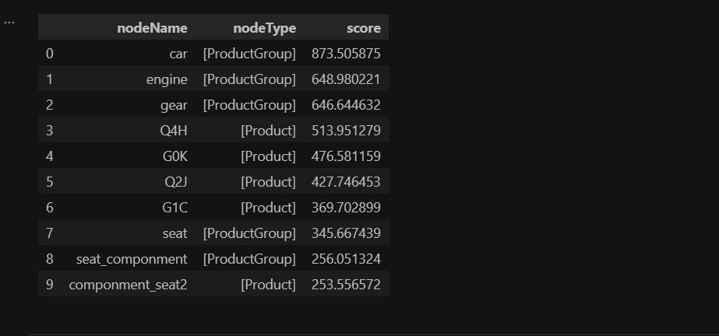
PageRank — Which Plants and Products Are Mission-Critical?
GDS 1 · Full network projection: 56,083 nodes · 171,163 relationships · 50 iterations · damping factor 0.85
How it works
Full PageRank results — all node types ranked by network influence
PageRank was originally built by Google to rank web pages. We apply the same logic to our supply chain. We chose PageRank over alternatives such as Betweenness Centrality and Degree Centrality for three reasons:
A facility scores high if many other important facilities depend on it — meaning a disruption there would cascade through the most production paths.
Think of it as asking: if this assembly plant or supplier went dark tomorrow, how many production lines would stop?
We project the entire network — every assembly plant, every supplier, every product — into memory and score all 56,083 nodes simultaneously.
Why PageRank over other algorithms:
vs Degree Centrality: Degree only counts direct connections. PageRank propagates influence iteratively — a node connected to high-influence suppliers scores higher. Essential in a multi-tier supply chain.
vs Betweenness Centrality: Betweenness measures shortest-path bottlenecks. PageRank measures influence flow — more appropriate for cascading disruption risk in production networks.
vs Closeness Centrality: Closeness treats all edges equally. PageRank respects the directionality of supply flow — critical in a directed production network where materials only move one way.
Moetz et al. (2020) · Neo4j Graph Data Science · Spring 2026 Capstone

Slide 6
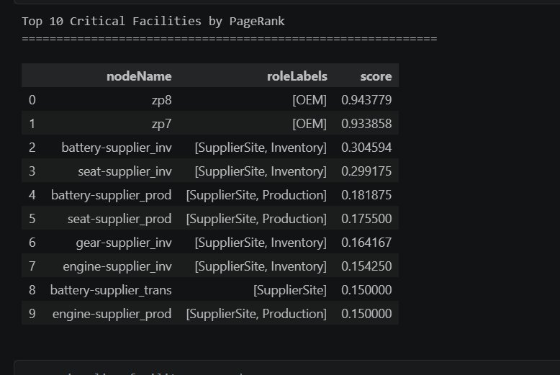
PageRank Results — Top 10 Critical Facilities
GDS 1 · Facilities only — ranked by cascade influence across the full supply network
Top 10 assembly plants and supplier sites by PageRank score
What this means for the business
zp8 & zp7 (OEM Plants) (0.94 / 0.93)
Final assembly plants score highest. Every component from every supplier converges here. A stoppage at either plant halts the entire vehicle production line.
battery-supplier_inv
seat-supplier_inv (0.30 / 0.30)
Tier-1 inventory hubs for battery packs and seat assemblies. These are the last buffer before the OEM plant — the thinnest safety net in the chain.
Gear & engine
Tier-1 nodes (~0.15–0.18)
Mid-tier influence. Important but have more redundant sourcing paths than battery and seat.
Moetz et al. (2020) · Neo4j Graph Data Science · Spring 2026 Capstone

Slide 7
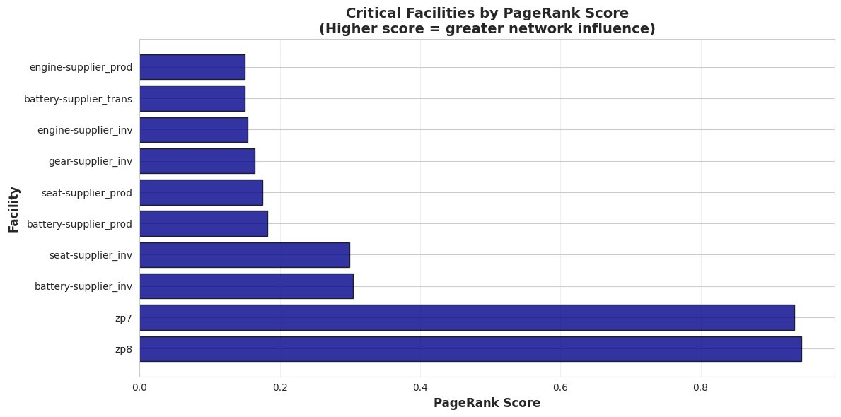
PageRank — Visualised: The Cascade Risk Hierarchy
GDS 1 · Higher score = greater cascade risk if this facility is disrupted
Critical facilities by PageRank score — zp8 and zp7 dominate
Key Takeaways
▶
zp7 & zp8 are in a completely different risk category — their scores (~0.94) are 3× higher than all Tier-1 suppliers
▶
battery-supplier_inv and seat-supplier_inv are the most exposed Tier-1 nodes — thin buffers feeding the OEM chokepoint
▶
Gear and engine nodes carry distributed risk — important but not single points of failure
▶
Transit nodes score lowest — they are pass-through corridors, not consolidation points
Moetz et al. (2020) · Neo4j Graph Data Science · Spring 2026 Capstone

Slide 8
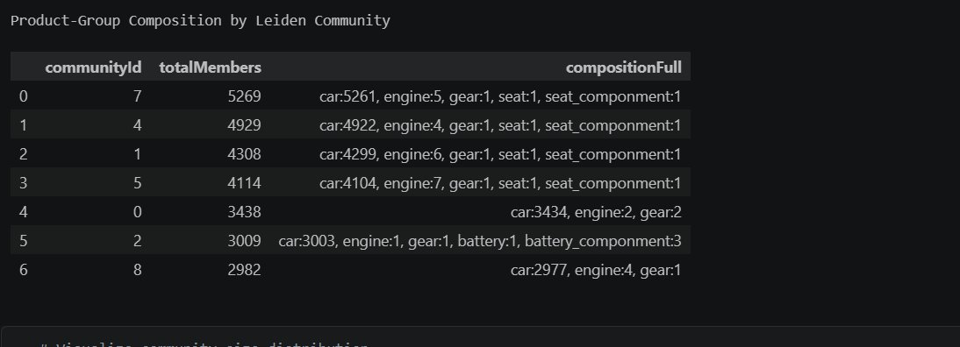
Leiden Community Detection — Natural Planning Zones in the BOM
GDS 2 · Product-only projection: 28,049 products · 174,118 bill-of-materials edges · quantity-weighted
How it works
Product-group composition of each Leiden community — 7 natural planning zones identified
Leiden is a community detection algorithm that finds groups of products that are more tightly connected to each other than to the rest of the network.
In automotive terms: it finds natural product families that share the same components and sub-assemblies — the groups that would be affected together if a supplier fails.
We run it on a product-only BOM graph — 28,049 vehicle and component SKUs connected by 174,118 bill-of-materials edges — so the clusters reflect pure assembly dependency, not logistics noise.
Key advantage over older algorithms: Leiden guarantees every cluster is internally connected — no isolated products are misassigned to a group.
Moetz et al. (2020) · Neo4j Graph Data Science · Spring 2026 Capstone

Slide 9
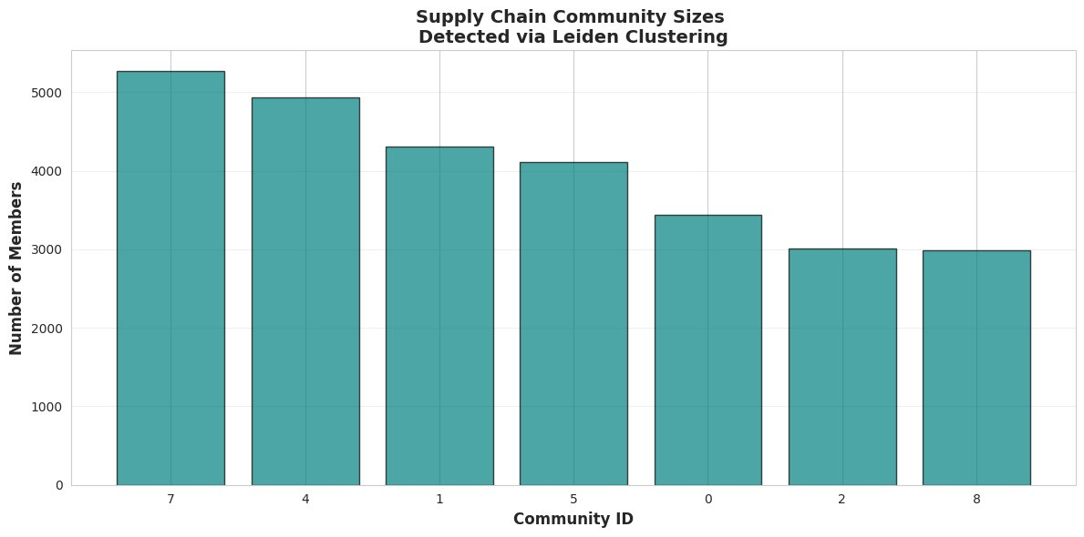
Leiden Results — 7 Natural Vehicle Production Clusters
GDS 2 · Each bar = one planning zone. Size = number of products sharing the same BOM dependency cluster
Supply chain community sizes detected via Leiden clustering
Business Meaning
▶
7 planning zones instead of 28,049 individual products — procurement and operations teams can now work at zone level
▶
Community 5 is the battery cluster — 3,009 products that share battery and battery_component dependencies. A battery disruption stays contained here
▶
The four largest communities are all car-heavy — seat, gear, engine dependencies dominate the biggest clusters
▶
No community has internal redundancy — disruption within a zone has no backup path. Each zone needs its own resilience plan
Zone 7 (largest): 5,269 products
car + engine + gear + seat families
Zone 4: 4,929 products
car + engine + gear + seat families
Zone 5 (battery): 3,009 products
car + battery + battery_component
Moetz et al. (2020) · Neo4j Graph Data Science · Spring 2026 Capstone

Slide 10
What Graph Data Science Tells the Business
Two algorithms. One clear operational picture.
PageRank
Finding
zp7 and zp8 — the OEM final assembly plants — are the highest-risk nodes in the entire network. Every component from every supplier must pass through them. Protecting these two plants is the single highest-value resilience investment.
Battery
Cluster
Community 5 (3,009 products) is the dedicated battery cluster. Disruption here stays contained — but there is no internal redundancy. The entire zone depends on a single production route capped at 294 units per week.
Tier-1
Exposure
battery-supplier_inv and seat-supplier_inv are the next most critical. They are the last inventory buffer before the OEM convergence point — and both feed components with 20–23 week lead times and 294-unit capacity ceilings.
Operational
Action
Manage disruption response at zone level (7 zones) rather than SKU level (28,049 products). When battery-supplier_inv is disrupted, activate the Community 5 contingency plan — not a product-by-product assessment.
Leiden
Finding
The product BOM naturally segments into 7 planning zones ranging from 2,982 to 5,269 products. This is not an arbitrary grouping — it reflects genuine structural dependency in the bill of materials.
Strategic
Value
Graph algorithms produce ranked, network-wide outputs that Cypher queries alone cannot. They turn 56,083 nodes and 171,163 relationships into two actionable outputs: a critical node ranking and a planning zone map.
Next steps: Real-time disruption simulation · Dual-sourcing for seat and battery · Zone-level buffer optimisation
Moetz et al. (2020) · Neo4j Graph Data Science · Spring 2026 Capstone

